Slide 1
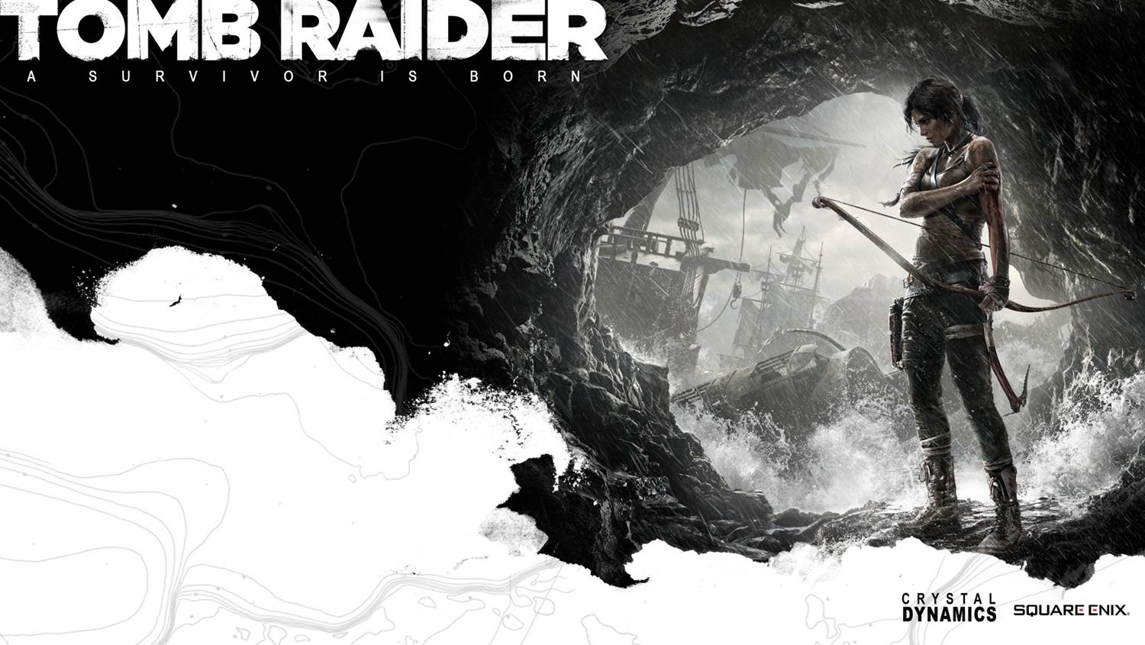
Casting a New Light on a Familiar Face: Light-Based Rendering in Tomb Raider
Jason Lacroix
Senior Rendering Engineer

Slide 2
Talking Points
Where we started
Making the case for deferred lighting
The Crystal Dynamics lighting system
Other lighting contributors
Light-based FX rendering
Optimizations
DX 11 enhancements
Looking forward

Slide 3

Where We Started
Tomb Raider: Underworld (November 2008)
Forward lighting
Heavy use of light maps

Slide 4
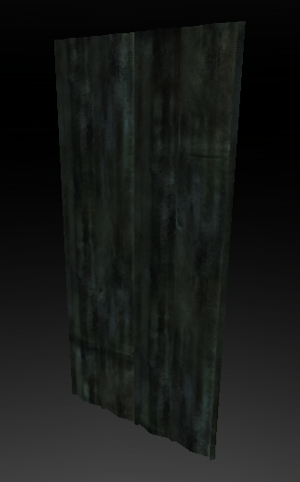
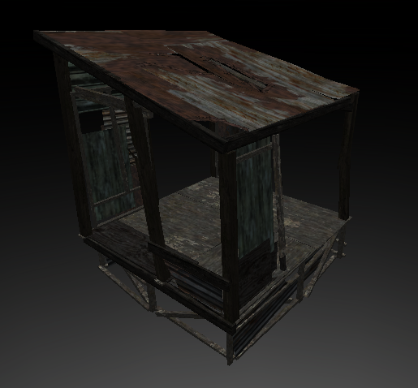
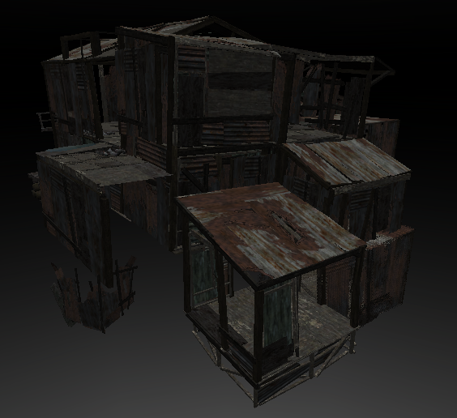
Light Map Problems With Regards to TR 2013
Moved to a modular workflow in Horizon
Limited team size
Rapid iteration
Emphasis on re-use as much as possible
High amount of destructibility in the world
Limited space in memory, and on disc
Materials already very complex
Can’t afford another set of textures for light maps

Slide 5
First Pass Deferred Lighting
Brought in from Deus Ex 3
Built on same foundations as Tomb Raider: Underworld
Was cumbersome to use
Had a separate workflow
Art team wasn’t really on board
Did not want to give up light maps

Slide 6

Selling the Team on Deferred
Set up a Pepsi® Challenge
Deferred vs. Lightmaps
Each team had 2 weeks to complete work on the same level

Slide 7
Selling the Team (Cont’d)
Team 1 (Light maps)
A lot of effort on scene cleanup
Many iterations of bakes to get right results
Final bake took about a day (on a single machine)
Team 2 (Deferred)
Rudimentary version of new lighting system implemented
Artist had about 3-4 actual days to light the level

Slide 8
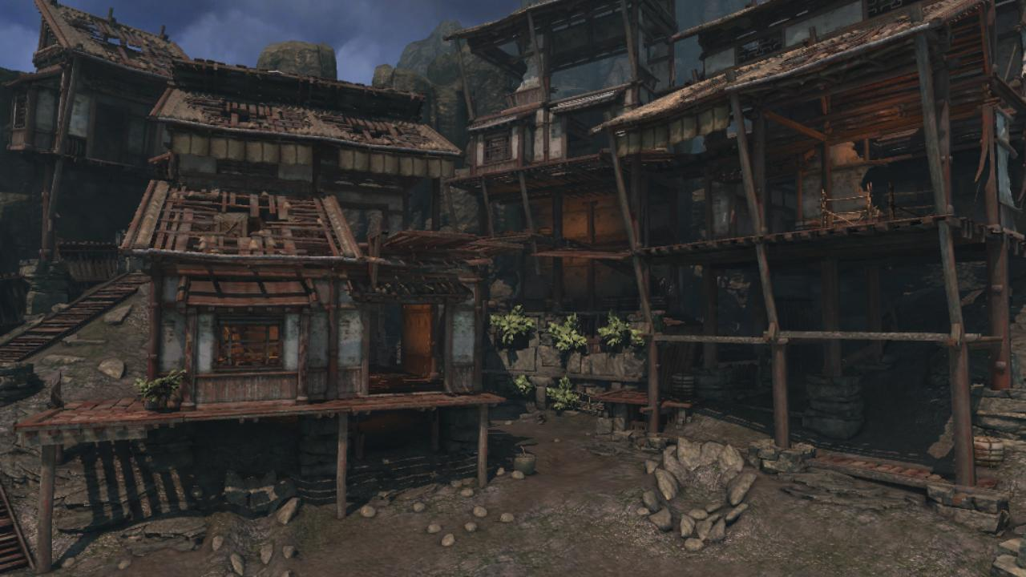
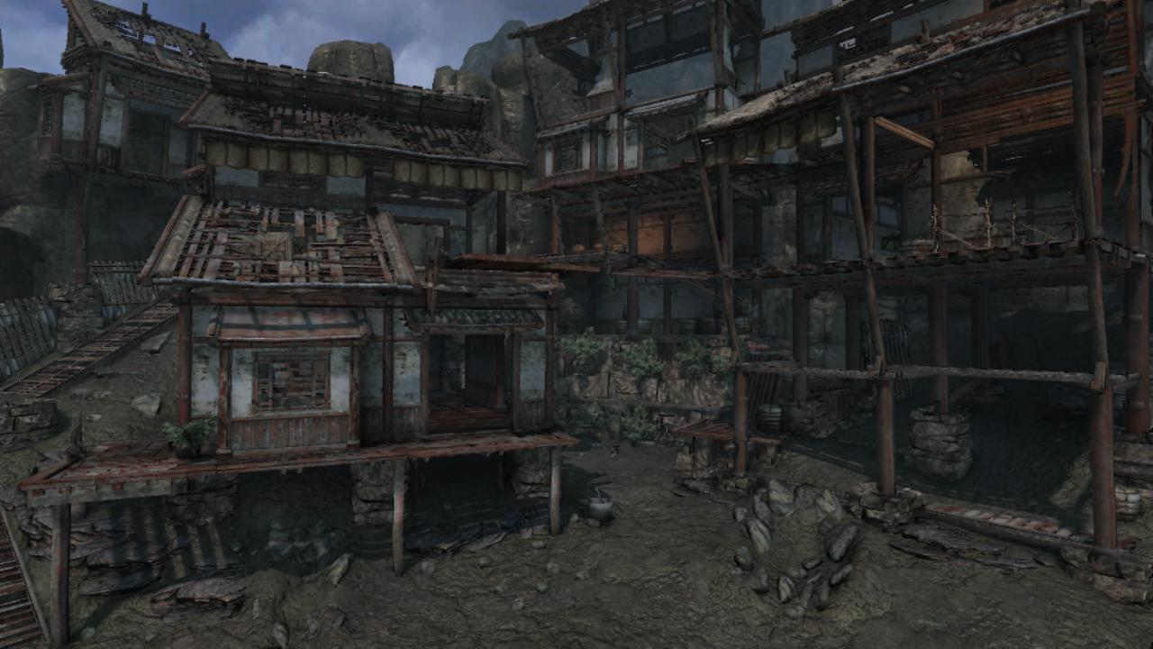
Results

Slide 9
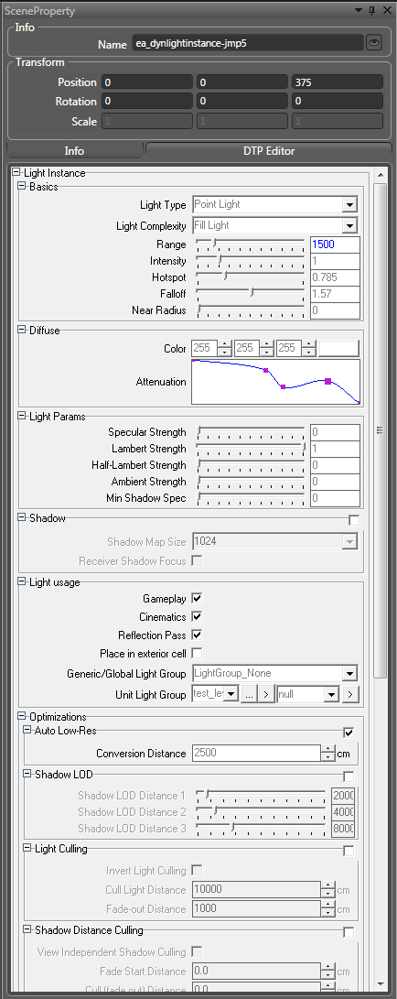
The Crystal Lighting System
Hybrid lighting solution
Deferred via accumulation buffer
Forward for translucents and complex materials
System is made up of various light types and light complexities
Combined with art driven lighting stages that are editable in real-time

Slide 10
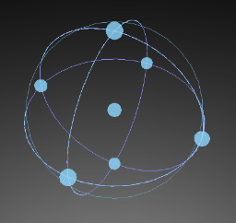
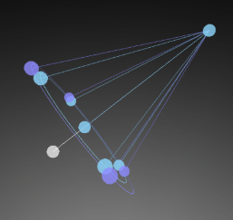
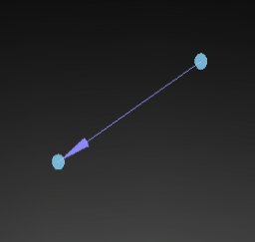
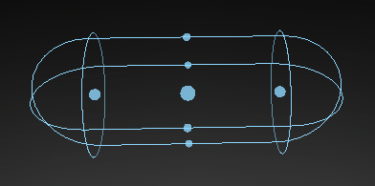
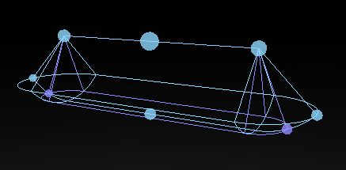
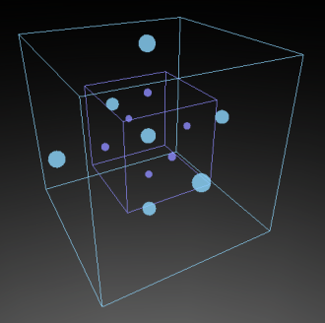
The Crystal Lighting System (Cont’d)
Light complexities
Universal
Fill
Dark
Player
+FX-based lights (later)
Light types
Point (Omni) Spot & Directional
Capsule
Wedge
Box

Slide 11
Light Stages
Many stages can be combined together for final light output
Light intensity variation
Attenuation curve application
Shadowing
Texture projection modulation

Slide 12
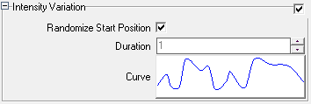
Intensity Variation
Art driven intensity curves
Multiplies with light’s intensity
Can start at a random offset (avoids repetitive patterns among lights)
Curves can be played back over any length of time
Intuitive UI

Slide 13
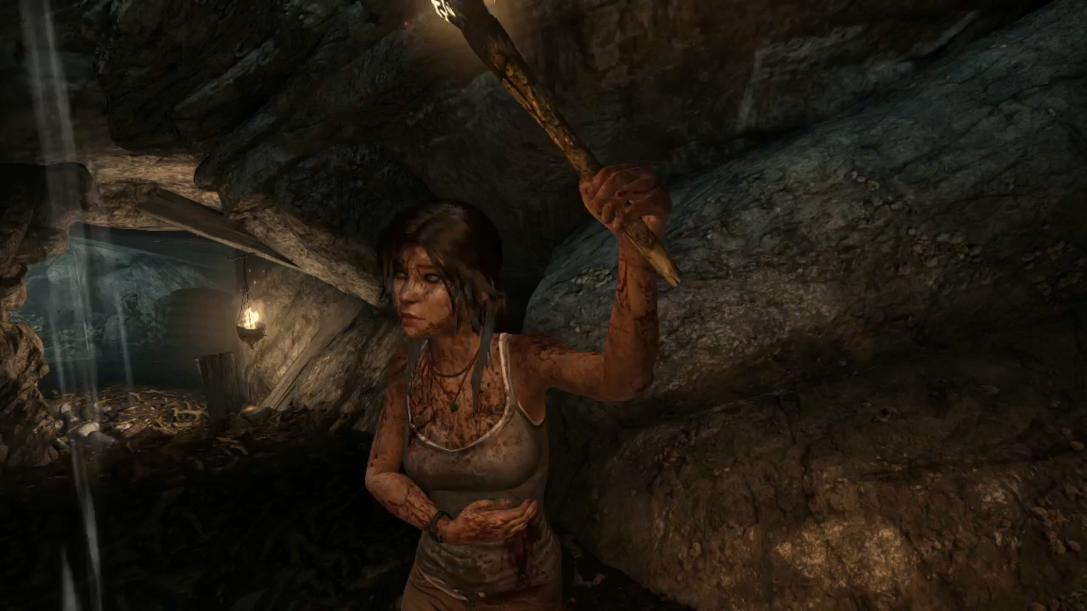
Intensity Variation (Cont’d)

Slide 14
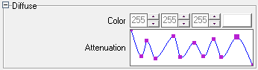
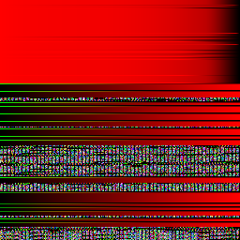
Attenuation Curves
Art driven attenuation curves
Same curve editing UI as intensity variation
Attenuation data is combined on the CPU and dumped into a texture
Attenuation curve along the U axis, different lights packed in along the V axis
Results can modulate standard attenuation calculations (linear/exponential falloff)

Slide 15
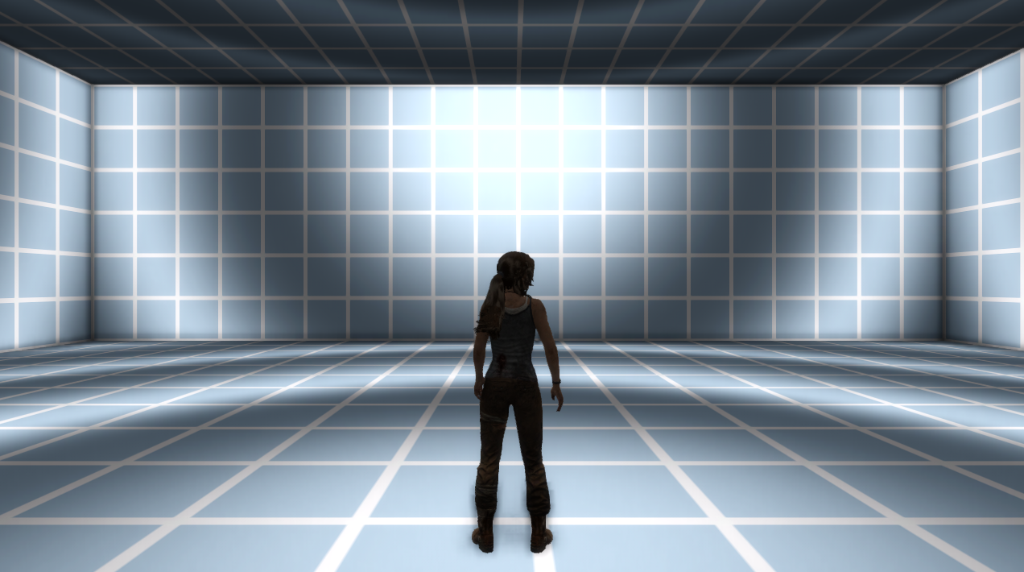
Attenuation Curves (Cont’d)
Result

Slide 16
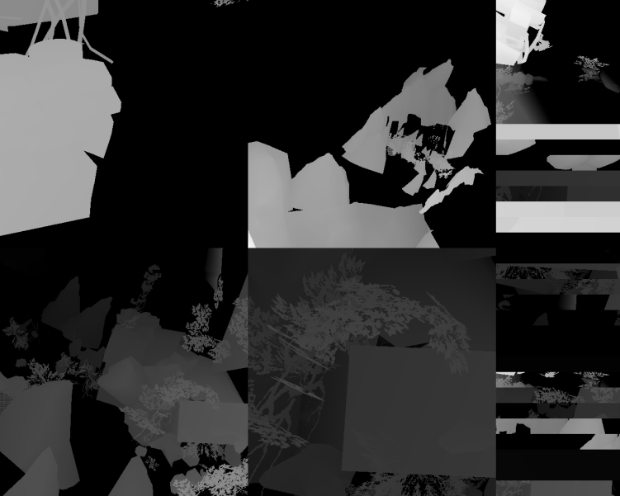
Shadowing
Support standard shadow map projection on spot lights and Parallel Split Shadow Maps on directional lights
Have support for Point shadow maps, but disabled due to cost
Faked in a few places with wide angle spots
No shadows for advanced light types (wedge, capsule, box)
Try to combine all maps into one very large texture and use offsets for proper lookup

Slide 17
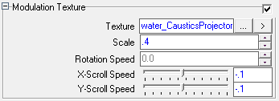
Texture Projection Modulation
Modulate light with a texture projection
Support for
Scaling
Rotation
Scrolling (vertical & horizontal)

Slide 18
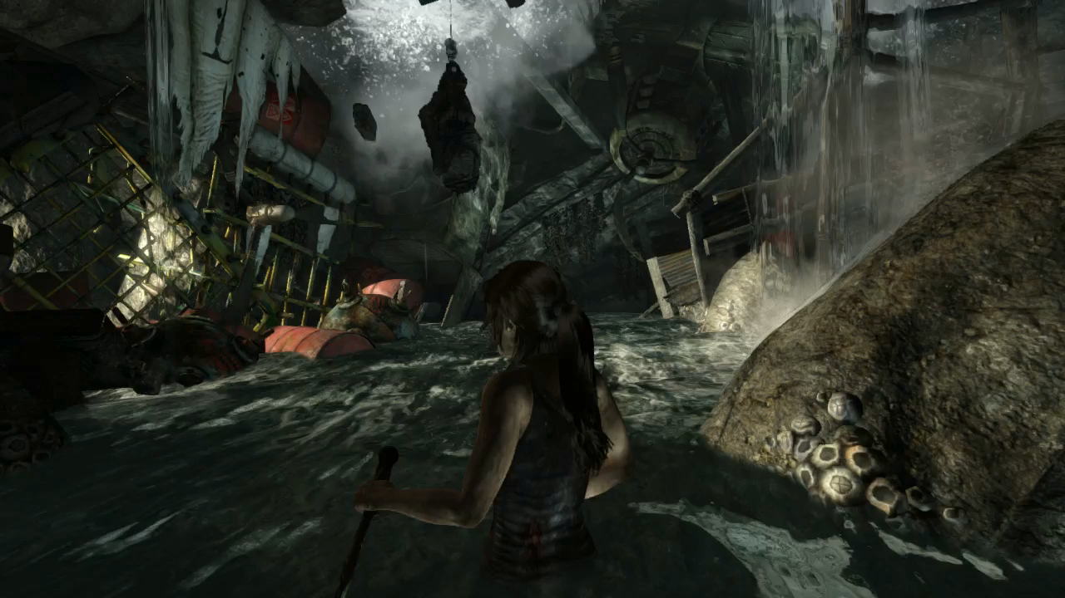
Texture Modulation (Cont’d)

Slide 19
Light Complexities
Universal lights
Combination deferred/forward light
Used when light must affect everything in the scene
Only point, spot, and directional lights can be universal
Fill lights
Deferred only lights
Spec is off by default (much cheaper shader)
Much cheaper on the CPU as they are flushed from the pipeline after render is scheduled
Supports all light types

Slide 20
Light Complexities (Cont’d)
Player lights
Beauty light for the player
Takes all player lights and combines them into one averaged light color and light direction
Computed on the CPU and applied during our composite pass

Slide 21
Light Complexities (Cont’d)
AO Dark Lights
Add to the scene ambient occlusion
Allows artists to shape the falloff of lighting even more
Used primarily for lighting corners, under hangs and such
Calculated like any other light, but end result removes lighting from scene rather than adding to it

Slide 22
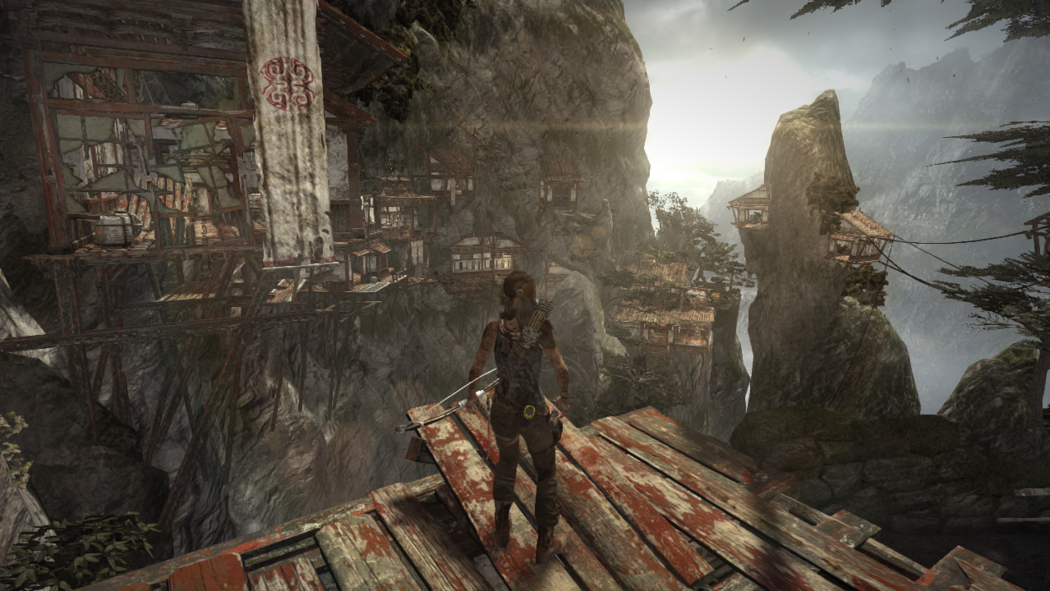

Slide 23
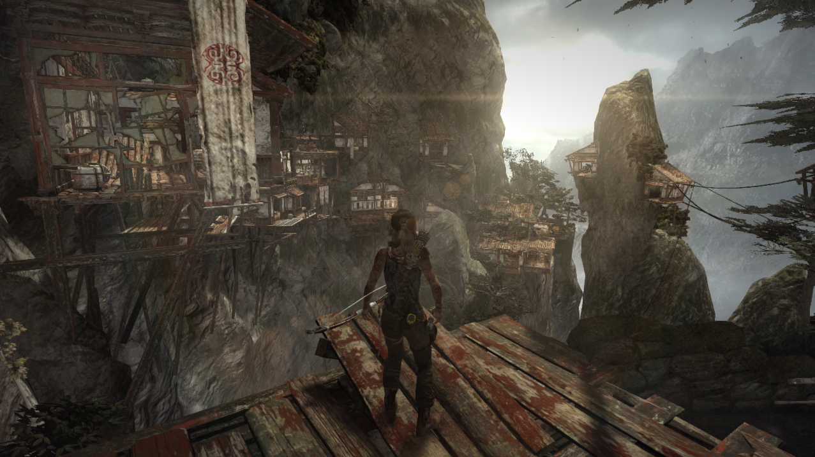

Slide 24
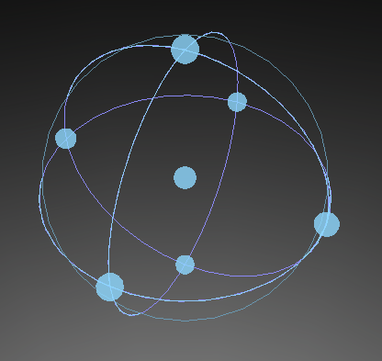

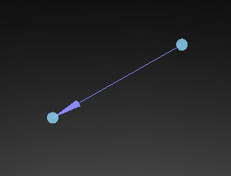
Light Types
Point (Omni)
Spot
Directional

Slide 25
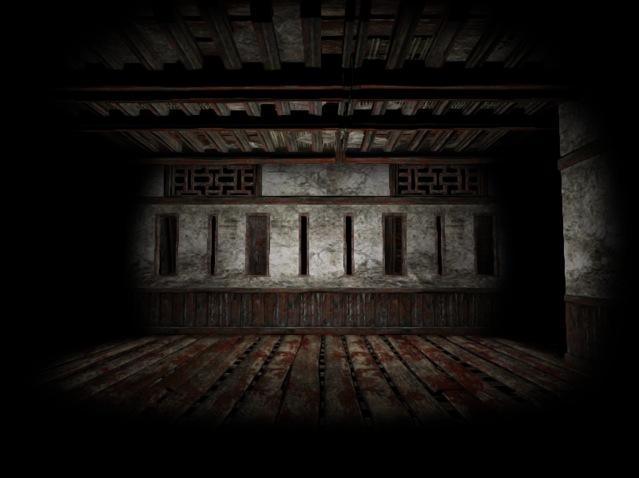
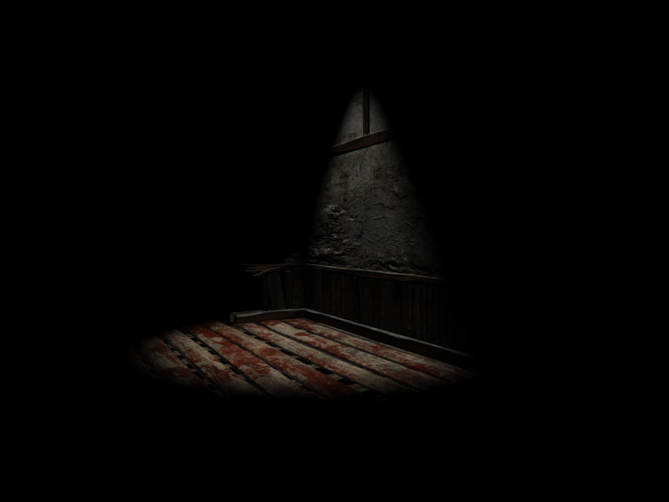
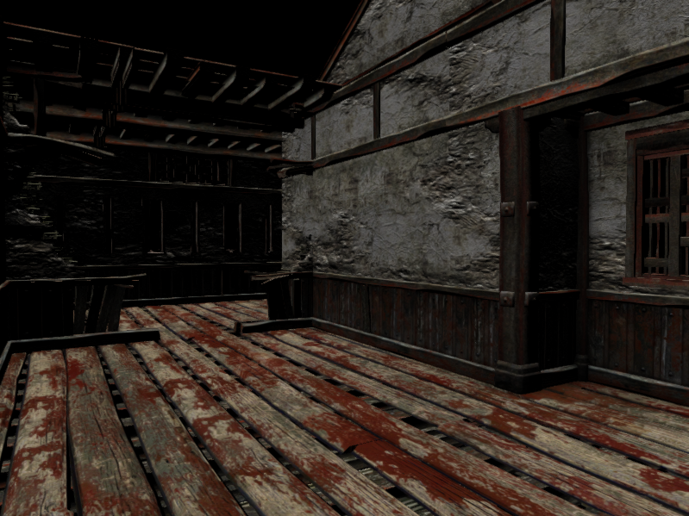

Slide 26
Light Types (Cont’d)
Capsule
Omni-directional light with a line segment as the source instead of a single point
Project position of pixel onto capsule line segment to determine closest position along capsule to use for light position in N dot L

Slide 27
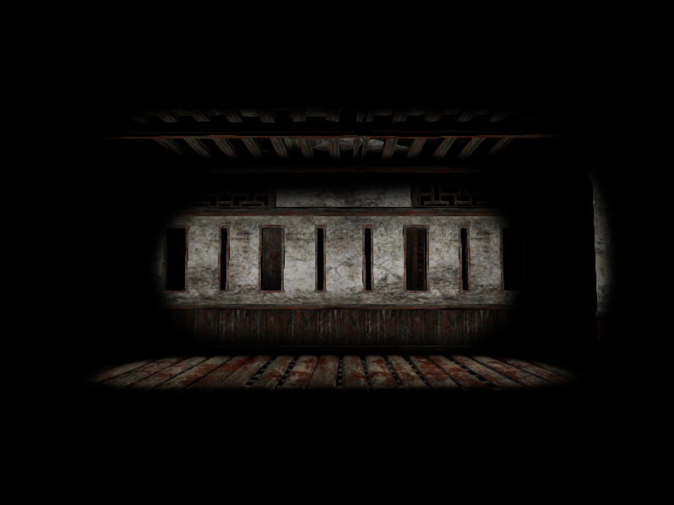

Slide 28
Light Types (Cont’d)
Wedge
Capsule light with spotlight angular falloff
Use the same line projection to map light position for N dot L
Great for darkening corners (when using dark lights)

Slide 29
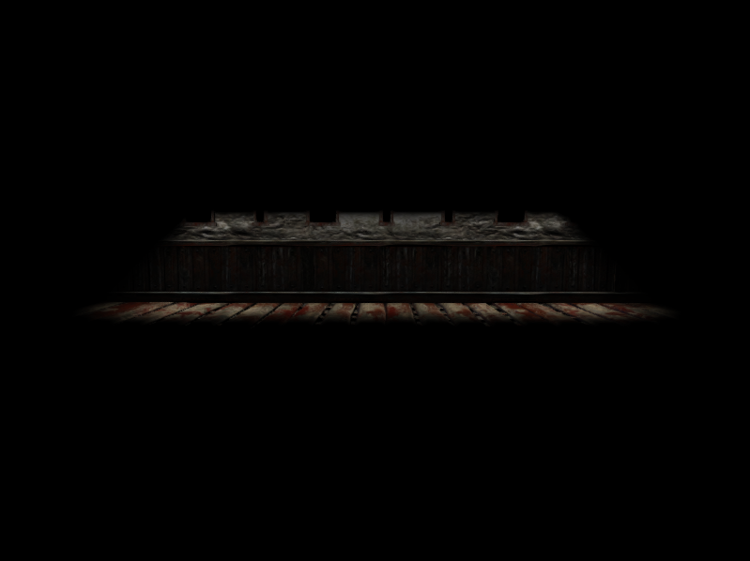

Slide 30
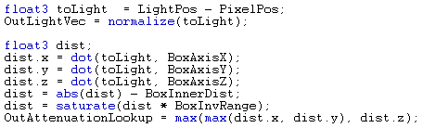
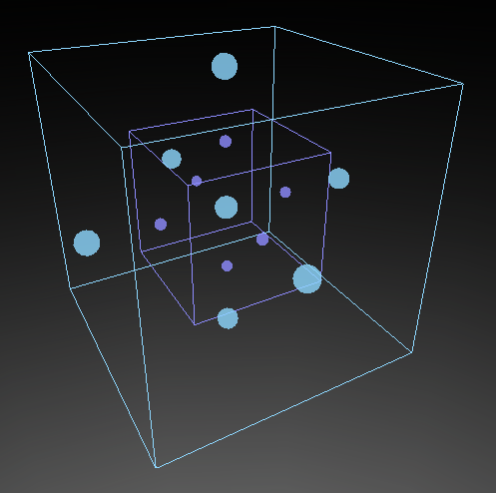
Light Types (Cont’d)
Box
Omni-directional light that falls off along each axis independently
Light attenuation texture lookup
BoxInnerDist is the inner plane distances
BoxInvRange is one over outer planes minus inner planes

Slide 31
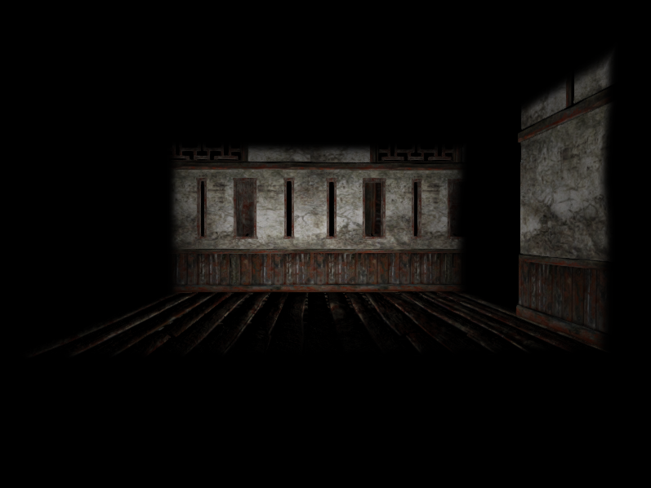

Slide 32
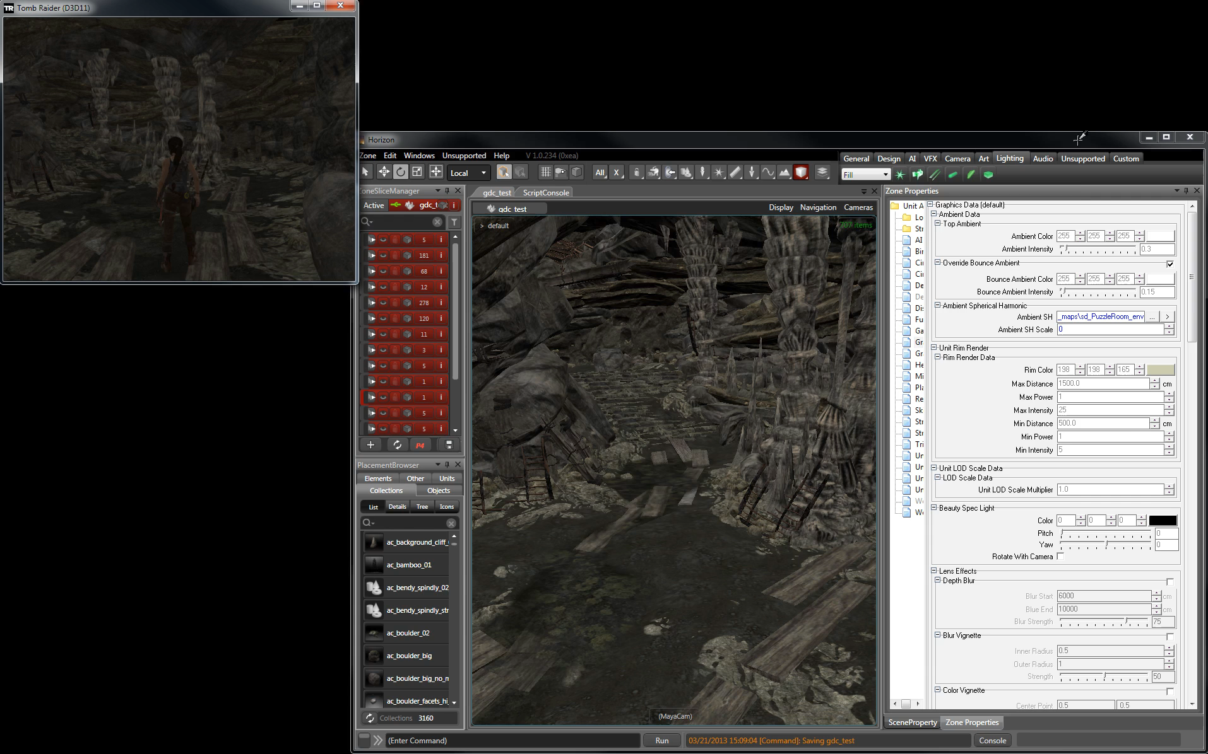
Crystal Dynamics Lighting System
All live editable from Horizon
See slides from Jason Yao’s talk for more information
Horizon and Beyond: A Look Into Tomb Raider’s Tools
Video

Slide 33
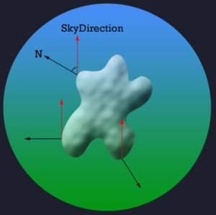

Other Lighting Contributors
Support for 2 ambient lighting methods
Top/Bottom hemispherical ambient
Bottom is auto-generated as half top if unspecified
Simple dot product with vertical normal component
Spherical harmonic ambient cube maps
Generated from locators placed in the world
Screen Space Ambient Occlusion
Developed our own SSAO technique over time

Slide 34
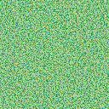
SSAO
Original implementation was based on [Filion-McNaughton 08]
Use a texture of random reflection planes to generate 4 normal lookup vectors
Use normal vectors to compute location to sample depth
Lookup depth and compare to center sample depth
Instead of using this result as SSAO, we process the results further and use a bent normal approach

Slide 35
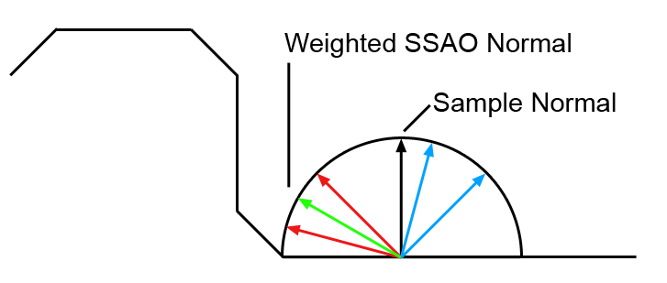
SSAO (Cont’d)
Scale AO depth difference at each sample from 0-1, and normalize to get a 4 component weight
Weights represent how much each sample contributes to AO
Store blended normal by performing a weighted average of the reflection normal vectors

Slide 36
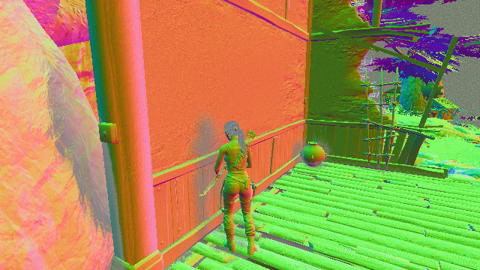
SSAO (Cont’d)

Slide 37
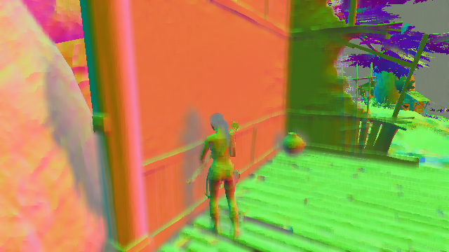
SSAO (Cont’d)
Apply a 9-tap weighted blur horizontally, then vertically
Weights calculated with comparison to between depth and normals surrounding pixel

Slide 38
SSAO (Cont’d)
When applying SSAO
Calculate bi-lateral up sampling weights from normal and depth buffers
Take 4 samples from blurred SSAO buffer
Combine them into a weighted blurred normal
Dot product with original hi-res normal at sample location
Result is an occlusion multiplier that is applied to the frame lighting

Slide 39
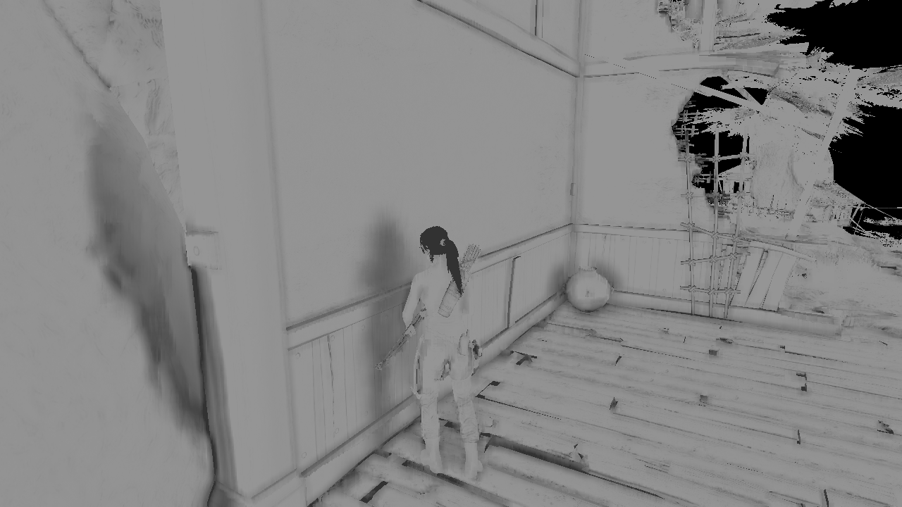
SSAO (Cont’d)

Slide 40
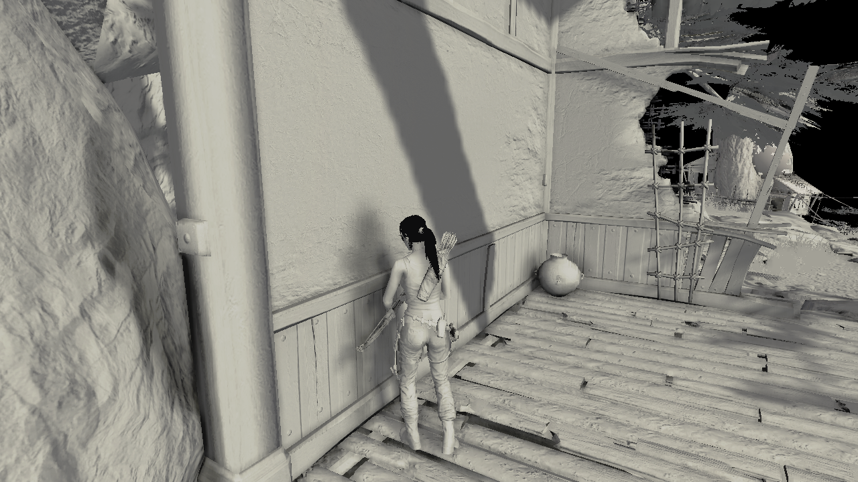
SSAO (Cont’d)

Slide 41
Light-Based FX
Had this great set of tools
Had new problems to solve
Applying environmental effects en masse without having to change materials (modularity issues)
At the time, needed to apply wetness to materials
Eventually, we were asked to make entire levels burn
Leveraged the existing system and created Wet lights and Fire lights

Slide 42
Wet Lights
Modifies scene specular to make it look like water is cascading down surfaces or pooling on the ground
Effect is composed of 2 overlapping lights
Dark light (automatically created), mimicking the darkening present on wet surfaces
Wet light, modifies specular to give it a sheen

Slide 43
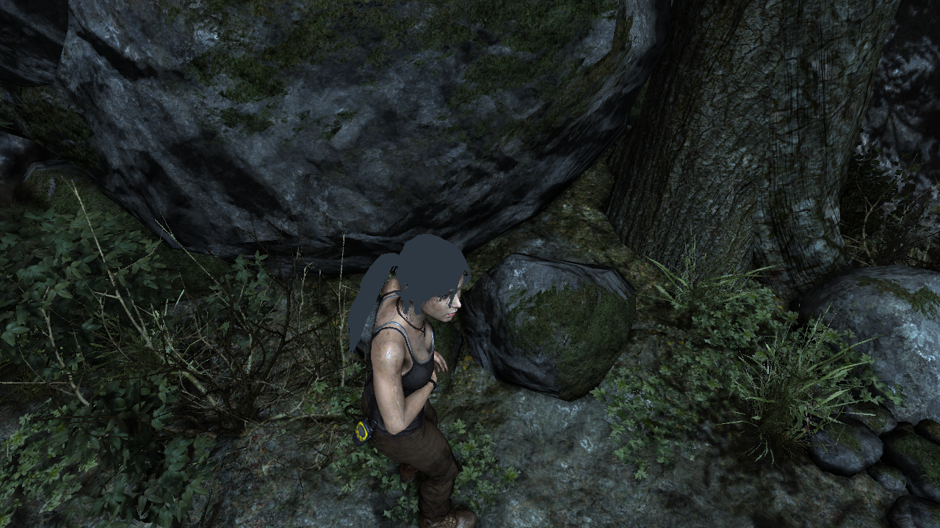

Slide 44
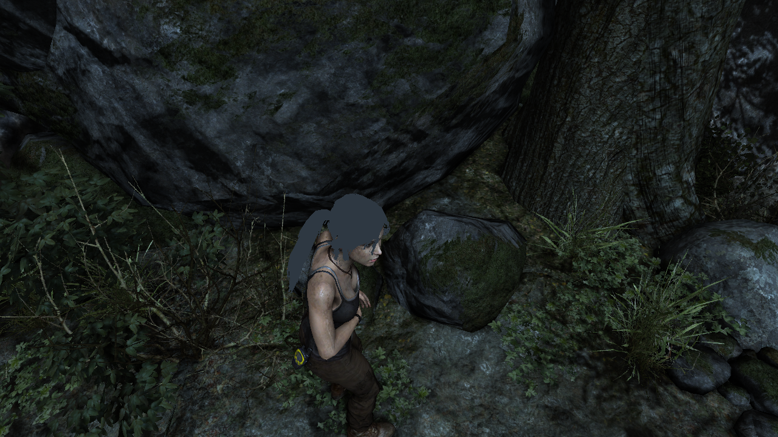

Slide 45
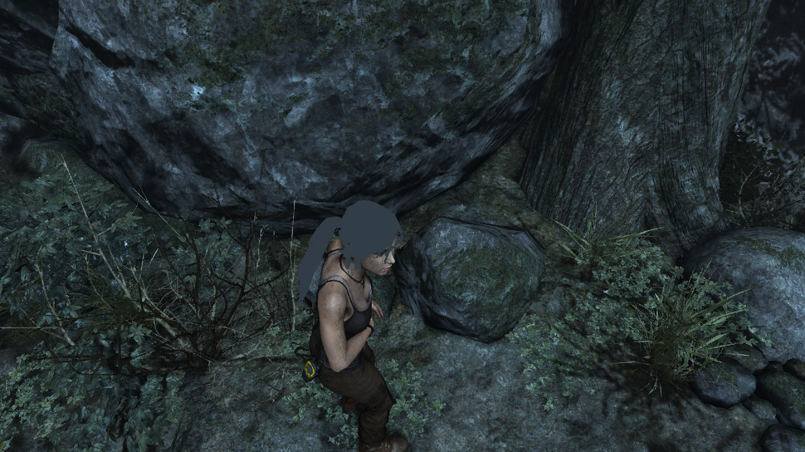

Slide 46
Wet Lights (Cont’d)
Dark light component is applied with other dark lights
Wet light is applied after lighting has been computed and composited into the scene
Uses world space normal and position (calculated from depth and normal buffer) to do tri-planar mapping

Slide 47
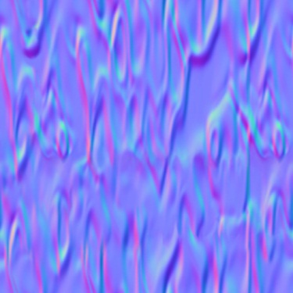
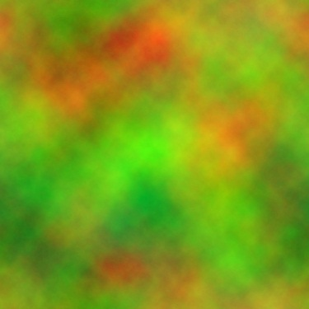
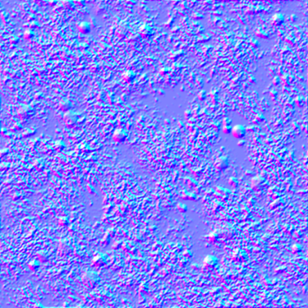
Wet Lights (Cont’d)
Lookup into side and bottom normal maps that are provided by artist on a per-level basis
Bottom lookup combines pooling and splashing normal maps
Normal maps are tiled and animated according to level settings and world position computed
Allows us to have faster water cascades and stronger splashes of rain
Clamp the negative y sample to zero to not get an effect on the underside of geometry

Slide 48
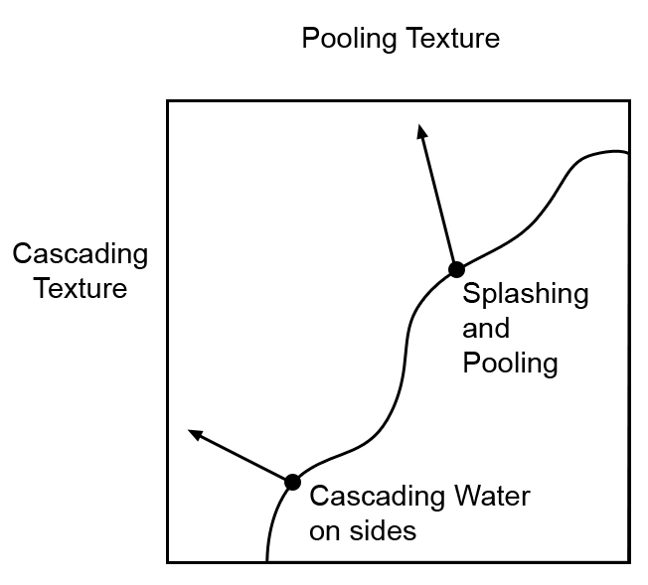
Wet Lights (Cont’d)

Slide 49
Wet Lights (Cont’d)
The computed wet normal is then blended with the original sampled normal according to strength setting
Resulting normal is used to perform an environment map lookup
Lookup optionally blends in lighting from light buffer
Take luminance of the resulting color for bloom control
Output is blended additively with scene

Slide 50
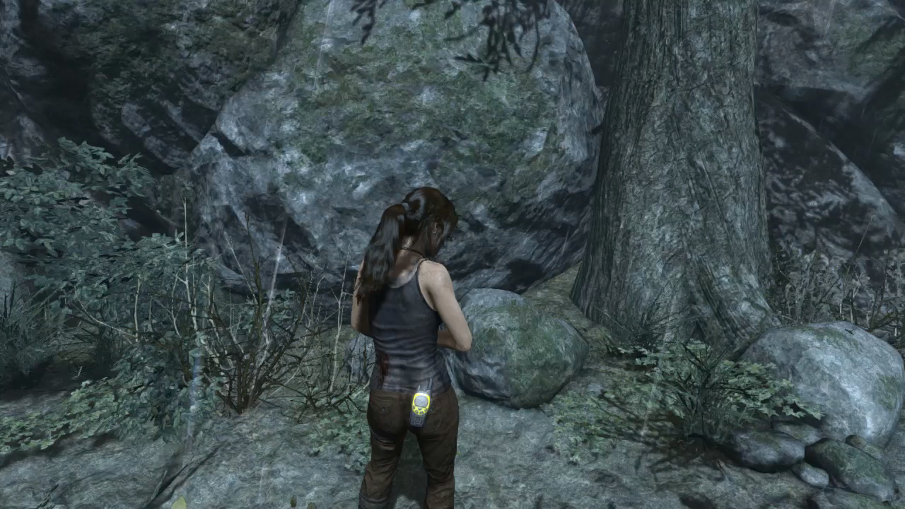
Wet Lights (Cont’d)
Results

Slide 51
Fire Lights
Need arose to make large scale set pieces burn
Without making art have to re-author a ton of materials (limited time, modularity)

Slide 52
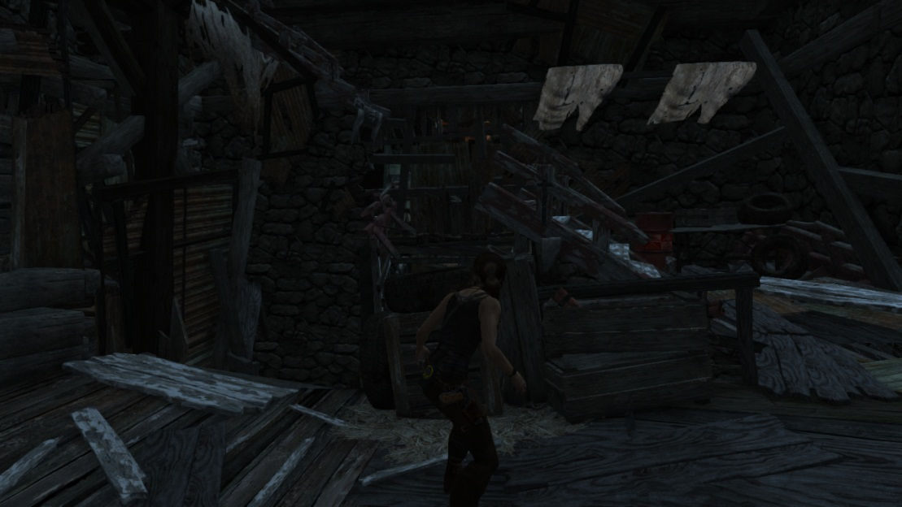

Slide 53


Slide 54
Fire Lights (Cont’d)
Fire lights authored just like other lights
Supports a subset of lighting stages (all but intensity variation)
Renders into a separate buffer
Flame/Char scale specified per light
Fire mask is the result of lighting attenuation
Burn speed controls how fast the burn comes in

Slide 55
Fire Lights (Cont’d)
The fire effect itself is applied during the composite pass
Shader is a little long (and expensive)
Requires a lot of texture samples

Slide 56
Fire Lights (Cont’d)
// A - Info Lookup
float3 finalEmissive = float3( 0, 0, 0 );
float4 scorchColor = float4( 0, 0, 0, 1 );
float4 fireTex = tex2D( FireTexture, PixelTexCoord );
float burnSpeed = fireTex.z;
float fireMask = fireTex.a;
float flameBlend = fireMask * burnSpeed;
bool fireOn = ( flameBlend > 0.0 );
#ifdef Xenon
[branch]
#endif
if ( fireOn )
{
// B – Roll in burn mask and flame map
float2 scaleParams = float2( fireTex.x, fireTex.y ) * 10000;
// Projection calculations for Burn Mask and Flame Map
scaleParams = 1.f/scaleParams;
// Get the projection coordinates
float3 burnMaskPos = scaleParams.y * WorldPosition;
float3 flameMapPos = scaleParams.x * WorldPosition;

Slide 57
Fire Lights (Cont’d)
// Do the lookup for the burn mask
float2 XProj;
float2 YProj;
float2 ZProj;
float4 burnMaskValue;
ProjectionCoords( burnMaskPos, XProj, YProj, ZProj );
TextureTripleTap( BurnMask, XProj, YProj, ZProj, Normal, burnMaskValue );
burnMaskValue = saturate( burnMaskValue - ( 1.f – burnSpeed ) );
// C - Calculate distortion info
float3 distortion = cdcSampleNormalTexture( DistortionMap, HeatDistortionSpeed, true, false );
distortion.xy *= HeatDistortionScale;
distortion = distortion * burnMaskValue.y * fireMask;
float2 scrollOffset = ProjectionScroll + distortion.xy;
// D - Do the lookup for the flame map
float4 flameMapValue;
ProjectionCoords( flameMapPos, XProj, YProj, ZProj );
XProj += scrollOffset;
YProj += scrollOffset;
ZProj += scrollOffset;
TextureTripleTap( FlameMap, XProj, YProj, ZProj, Normal, flameMapValue );

Slide 58
Fire Lights (Cont’d)
// E - Calculate the glowing of the flame with sin wave
float glow = sin( Time );
glow = ( ( glow + 1 ) / 2 ) * ( 1.5 ) + 0.5;
// F - Use distortion calculation to fold in the scorch map
float2 scorchMapUV = ScorchUV + distortion.xy;
scorchMapUV *= tileUV;
scorchMapUV += offsetUV;
scorchColor = tex2D( ScorchMap, scorchMapUV );
scorchColor *= ScorchTint;
// G - Calculate Emissive and Charring contributions
float burnAmount = burnMaskValue.y * scorchColor.w;
// Charing
float glow1 = pow( max( burnAmount, 0 ), 4 );
float glow2 = pow( max( burnAmount, 0 ), 8 );
float3 charAmount = saturate( glow1 - glow2 ) * CharGlow;

Slide 59
Fire Lights (Cont’d)
// Emissive
float3 emissive = FlameColor * flameMapValue;
emissive = emissive * burnAmount * scorchColor.w;
emissive = emissive * flameBlend;
emissive *= glow;
finalEmissive = emissive + ( charAmount * fireMask );
}
// H - Use the results to blend for the final output values ...
DiffuseOut = ( scorchColor * flameBlend ) + ( DiffuseMapColor * (1– flameBlend ));
SpecularOut = ( SpecMapColor * ( 1 – flameBlend ) );
EmissiveOut = finalEmissive;

Slide 60
Fire Lights (Cont’d)
void ProjectionCoords( in float3 pos, out float2 XProjectCoord, out float2 YProjectCoord, out float2 ZProjectCoord )
{
float3 negativePos = -pos;
XProjectCoord = float2( pos.y, negativePos.z );
YProjectCoord = float2( pos.x, negativePos.z );
ZProjectCoord = float2( pos.x, negativePos.y );
}
void TextureTripleTap( sampler texSampler, in float2 coordX, in float2 coordY, in float2 coordZ, in float3 normal, out float4 results )
{
float4 texColor0 = tex2D( texSampler, coordX );
float4 texColor1 = tex2D( texSampler, coordY );
float4 texColor2 = tex2D( texSampler, coordZ );
float value0 = abs( dot( normal, float3( 1,0,0 ) ) );
value0 = saturate( pow( value0, 2 ) );
float value1 = abs( dot( normal, float3( 0,1,0 ) ) );
value1 = saturate( pow( value1, 2 ) );
float value2 = abs( dot( normal, float3( 0,0,1 ) ) );
value2 = saturate( pow( value2, 2 ) );
results = (texColor0 * value0) + (texColor1 * value1) + (texColor2 * value2);
}

Slide 61


Slide 62


Slide 63

Fire Lights (Cont’d)
Results

Slide 64

Frame Breakdown
Let’s take a look at how our rendering frame breaks down

Slide 65

Frame Breakdown (Cont’d)
Render all shadow maps

Slide 66
Frame Breakdown (Cont’d)
Remainder of frame organized by scenes
Each scene linked to camera
Each consists of all following passes

Slide 67


Frame Breakdown (Cont’d)
Normal/Depth pass

Slide 68



Frame Breakdown (Cont’d)
2. Depth/Normal Downsample

Slide 69

Frame Breakdown (Cont’d)
3. Dark lights and low-res lights (later)

Slide 70

Frame Breakdown (Cont’d)
4. Fire lights

Slide 71


Frame Breakdown (Cont’d)
5. SSAO generation

Slide 72

Frame Breakdown (Cont’d)
6. Light buffer generation

Slide 73

Frame Breakdown (Cont’d)
7. SSAO/Ambient/Low-res/Dark light application

Slide 74


Frame Breakdown (Cont’d)
Composite pass

Slide 75

Frame Breakdown (Cont’d)
Fog application

Slide 76

Frame Breakdown (Cont’d)
Wet light application

Slide 77


Frame Breakdown (Cont’d)
Translucents

Slide 78


Frame Breakdown (Cont’d)
Post-processing

Slide 79
Optimizations
Rendering as many lights as we do can get expensive
Came up with a number of optimizations to save time
Linear world depth targets
Light bounding volumes
Low-res lights
Particle lighting optimizations

Slide 80
Optimizations (Cont’d)
Linear world depth targets
We generate a half and quarter res version of the depth buffer
Also generate linear world space versions of said buffers
Allows us to save on conversion instructions when having to sample depth (which happens A LOT)

Slide 81
Optimizations (Cont’d)
Light bounding volumes
When rendering deferred lights, we use a 2 sided stencil to pick up only the area of affect
First pass deferred lighting used screen space quads to do light application
This became a CPU bottleneck (250+ lights in a frame)
As an optimization, started rendering transformed light bounding box for application
Very little impact on GPU, HUGE impact on CPU

Slide 82
Optimizations (Cont’d)
Low-res lights
Having lots of lights was taking a toll on the GPU
Low-res lights were a great solution to the problem
Lights are rendered at half resolution in a buffer shared with dark lights (in the alpha channel)
They do not do any spec calculations or shadowing
They are applied with dark lights during SSAO/Ambient fold in
Re-use bi-lateral upsample weights computed for SSAO
Auto created when lights get beyond a certain range

Slide 83


Slide 84
Optimizations (Cont’d)
Particle lighting
Per pixel particle lighting was far too expensive given the amount of particles we have in a frame
Gather 4 nearest lights + directional at each emitter and store an averaged light color and direction (similar to player light)
This light color/direction is then applied at the particle level, reducing lighting to a dot product and a multiply instruction

Slide 85


Slide 86
DX 11 Enhancements
PC version of the game handled by Nixxes
With exception of TressFX (Crystal Dynamics)
New SSAO techniques
Modified Multi-Resolution of AMD’s HDAO technique

Slide 87


Slide 88


Slide 89
DX 11 Enhancements
Wet light enhancements
Added screen space reflections to wet highlights
Lighting and Shadowing
Contact hardening shadows
High precision light accumulation buffer

Slide 90


Slide 91


Slide 92
Looking Ahead
Compute-based lighting
More complex lighting models
Physically correct lighting
The next few years should be very interesting

Slide 93
Special Thanks
Nixxes
Jurjen Katsman
Tim Van Klooster
Crystal Dynamics
The Horizon team
The entire Tomb Raider team

Slide 94
End
Thanks for your time
Swag bag giveaway
Please fill out your surveys
Make next year’s GDC even better!!
Questions?

